Slide 1
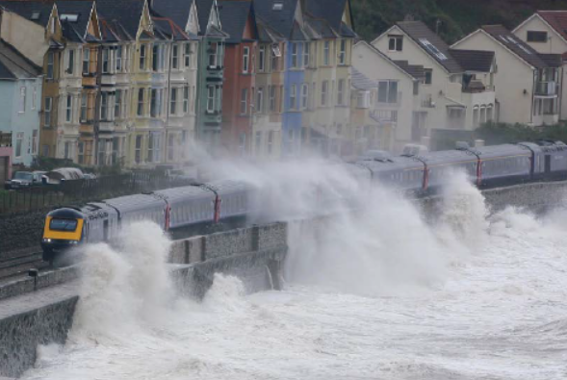
WRITING PROSE Example question and how to get top marks
You are going to enter a creative writing competition. Your entry will be judged by a panel of people of your own age. Either: Write a description suggested by this picture: Or: Write the opening part of a story about a place that is severely affected by the weather. 24 marks for content and organization 16 marks for technical accuracy (Total 40 marks = 25% of GCSE)
Content | Register is convincing and compelling for audience Assuredly matched to purpose Extensive and ambitious vocabulary with sustained crafting of linguistic devices
Organisation | Varied and inventive use of structural features Writing is compelling, incorporating a range of convincing and complex ideas Fluently linked paragraphs with seamlessly integrated discourse markers
Technical accuracy | Wide range of punctuation is used with a high level of accuracy Uses a full range of appropriate sentence forms for effect Uses Standard English consistently and appropriately with secure control of complex grammatical structures High level of accuracy in spelling, including ambitious vocabulary Extensive and ambitious use of vocabulary
What to expect…
As a stimulus for students’ writing, there will be a choice of scenario, written prompt or visual image that is related to the topic of the reading text in section A. The scenario sets out a context for writing with a designated audience, purpose and form that will differ to those specified on Paper 2.
Assessment Objectives
AO5 Content and Organisation | Communicate clearly, effectively and imaginatively, selecting and adapting tone, style and register for different forms, purposes and audiences. Organise information and ideas, using structural and grammatical features to support coherence and cohesion of texts.
AO6 Technical Accuracy | Candidates must use a range of vocabulary and sentence structures for clarity, purpose and effect, with accurate spelling and punctuation. (This requirement must constitute 20% of the marks for each specification as a whole.)
The basics
Capital letters
Full stops
Question marks
Commas
Apostrophes
Consistent tense
Paragraphs
Homophone spellings
Connectives
Semi-colons
Colons
Vary sentence starts/lengths
Vary paragraph lengths
Topic sentences
Stretch yourself
For planning – mind map rather than spider diagram.
Learn some impressive vocab.
Break the rules!!!
Reveal slowly/quickly
Dialogue
Parenthesis
Ascending / descending tri-colon
Syndetic/asyndetic listing
Cohesion (topic sentence, pronouns, chains, prepositions, fronted adverbials)
Cyclical/non-linear structure
READ OTHER NOVELS/SHORT STOIRIES/POETRY/PLAYS –. IF YOU DON’T KNOW WHAT TO READ - ASK!
Sentence starts
Verb – Running quickly, she …… (make sure you finish sentence)
Adverb – Darkly, the night sky….
Adjective – Red light filled the …
Preposition – Down there, all...
Connective – However, his life…
Language devices
Simile
Metaphor
Personification
Onomatopoeia
Alliteration
Imagery
Symbolism
Oxymoron
Juxtaposition
Pathetic Fallacy
Narrative v descriptive
A narrative should include a lot of description.
A description should not include any narration.
The descriptive ‘rules’
No names for people
At least 5 zoom-ins
No person described for more than a paragraph
Minimum 5 senses
1-3 sentences of direct speech
Maximum 1 exclamation mark
3rd person
No thoughts
Present or past tense (not both)
Move the camera – like a film
The narrative ‘rules’
The story takes place within one hour
Maximum 3 characters
Maximum 3 sentences of direct speech
Show not tell
Minimum 1 adjective per sentence
Minimum 5 senses
Maximum 1 exclamation mark
3rd person
50 % description with zooms
Don’t ‘chat’ to the reader
A ‘small’ story – make the ordinary extraordinary
The Exam
45 minutes – 1 task – A choice of 2 tasks (1 descriptive or 1 narrative…. but could be 2xnarrative or 2xdescrpitve.)
Step one: read & highlight key words in question (including PAT/PAF/PAL)
Step two: Study the stimulus (picture) then choose one of the two questions
Step three: Plan 6 -8 things you can include, then put them in order (Steps 1 to 3 = 10 mins)
Step four: Write it’ (Step 4 = 30 mins) should be lots of crossing out to show ‘crafting’ Should be 1 ½ sides approx
Step five (MOST IMPORTANT): Lip check (Step 5 = 5 minutes)
Basic narrative structure
Setting
Character
Problem
Climax
Resolution

