Slide 1
Context: Purpose
Formal registers will normally be linked to impersonal functions
to instruct
to persuade
to inform
Informal registers will normally be linked to personal functions
to express feelings, attitudes and opinions
to be creative, entertain
to socialise (phatic)

Slide 2
Context: Register
Language changes according to use
These variations are called registers
e.g. a legal register, a scientific register, a medical register, a poetic register, a colloquial register
Each register shows how we adapt language according to the way in which we use it in a particular situation or context

Slide 3
Types of Speech
The main distinction is between spontaneous and prepared speech. Conversation is the most common kind of spontaneous speech. Examples of prepared speech include public speeches, radio talks, advertising voice-overs etc.
Some speech is partly prepared and partly spontaneous e.g. stand-up comedy.
Another distinction is that between face-to-face interaction and non-face-to-face interaction.

Slide 4
Functions of Speech
Why do we speak? Think about the variety of functions our speech can have.
Referential utterances provide information (e.g. The train station is two miles away).
Expressive utterances express the speaker’s feelings (e.g. This burger is disgusting).
Phatic utterances are more commonly known as ‘small talk’. They mean very little but are important in maintaining social relationships (e.g. Hello, Nice to meet you, remarks about the weather etc.)

Slide 5
Functions of Speech
Directive utterances occur when the speaker wants someone to do something (e.g. Can you turn the television down?).
Transactional exchanges are conversations in which the main emphasis is on getting something done e.g. a conversation in a shop between a salesperson and a customer.
Interactional exchanges contrast with transactional exchanges in that the main emphasis is on the social relationship between the participants e.g. casual conversation between friends.

Slide 6
Prepared Speech
Prepared talk is speech that has been planned before it is uttered.
An example of a piece of prepared talk would be a public speech.
Speeches have their own conventions and grammatical features.

Slide 7
Some ideas…
Parallelism
Repetition
Contrast / Antithesis
Tripling
Listing
Interrogatives
Use of first and second person
Parallelism
Sentence structure

Slide 8
Lexical and Phonological Aspects of Speech
Emotive Vocabulary
Hyperbole
Figurative Language
Phonology
When analysing a speech, never forget it is intended to be heard.
This means sound and rhythm are especially important.
Consider the rhythm of specific parts of the speech e.g. stress.
Look out for phonological devices such as alliteration, assonance and rhyme.

Slide 9
Spontaneous Speech
As you will have discovered in your conversation, even unplanned spontaneous speech has conventions…

Slide 10
Adjacency Pairs
Sequences of utterances called adjacency pairs create a recognisable structural pattern in spoken language.
They:
Follow one another
Are produced by different speakers
Have a logical connection
Conform to a pattern.

Slide 11
Adjacency Pairs
Questions and answers, greetings, and a command followed by a response are all examples of adjacency pairs.
A Can I come in?
B Of course you can.
A Shut that door now.
B I will any minute, just don’t nag.

Slide 12
Turn Taking
The order of turn-taking also structures spoken discourse. Participants are skilful in manipulating turns: usually only one person will speak at a time; despite the fact that turns vary in length.
Transitions from one speaker to another occur smoothly, often with no gap; the order of participation is not planned in advance, but speakers seem to instinctively identify when turns are coming to an end; and if an overlap does occur, it rarely lasts for long.

Slide 13
Topics
Topic shifts – changes of topic.
Topic loops – when a conversation returns to an earlier topic.
Agenda-setting – a speaker controlling changes of topic.

Slide 14
Repairs
It is natural to repair speech or to say ‘um’ or ‘er’. It doesn’t mean you are uneducated or ‘thick’!
You will have noticed from your spontaneous conversation that not everything is said smoothly in spontaneous speech.
These mistakes can cause temporary interruptions to the exchange while the speaker attempts to repair it.
Repairs
A repair resolves a problem that has arisen in conversation.
An example is a speaker correcting himself (I paid twenty no fifteen pounds for it). Alternatively, the repair may be carried out by the other speaker.

Slide 15
Feedback
An important element in conversation is the feedback that those being addressed give to the speaker to show that they are listening. Feedback (also known as back channel behaviour) can take various forms:
Verbal responses such as Yeah, Really? etc.
Oral signals such as mm, uh, huh, laughs, sighs etc.
Non-verbal responses such as nods and smiles.
Failure to give such feedback can be disconcerting for the speaker. Note also that feedback can be negative as well as positive (e.g. looking away can indicate boredom or impatience).

Slide 16
Openings and Closings
Openings and closings are marked by distinctive features.
Social equals might use a neutral starting point or opening in a conversation by talking about the weather. This may lead into a self-related comment (focusing on the speaker) or an other-related comment (focusing on the listener).
Vocatives are common as they help to personalise an encounter.

Slide 17
Openings and Closings
Speakers have a wide range of possible openers to draw on like social greetings or hospitality tokens (linguistic references to customary social acts that are used to receive and entertain guests).
Spoken Words | Comment
A morning (.) oh (.) Richard (.) I must tell you about the holiday + B = ah (.) I was going to ask about that | The first speaker establishes the topic. He initiates the discourse with a phatic opening, a vocative and a self-related comment. The second speaker adopts a supportive role by creating a link between ‘self’ and ‘other’.
A come in (.) Peter (.) hang on a sec I’ve got to turn the oven off (4) do you want a drink = B = thought you’d never ask | The use of the vocative and imperative show that the speaker is focusing on the other participant in the conversation. Speaker B’s response is directly related to the last part of the first speaker’s utterance, creating an adjacency pair.

Slide 18
Openings and Closings
Closings are used to sum up the exchange. Reference is often made to something outside the speech encounter as a reason for ending the discourse.
Closings are often repetitive since the speakers use delaying tactics, referring back to earlier topics and adopting frequently occurring formulae.
Spoken words | Comment
A better be off now (.) I know you’re busy (.) enjoy yourself tomorrow (.) B I’ll make sure I do (.) thanks for coming = A = have a lovely time = B = I will (.) and thanks again = A = thanks (.) bye (.) B bye = | An other-related remark is used as a reason for ending the speech encounter. This is followed by a return to an earlier topic (reference to an event taking place on the next day). Both of these establish conventional patterns in which speaker A focuses interest on Speaker B. The exchange is clearly repetitive – social formulae are reiterated.

Slide 19
Spontaneous Speech: Lexis
Vocabulary is likely to be less formal. Ways this may be evident include:
Colloquial language
Regional dialect vocabulary
Elision / contractions
Phatic utterances
Deictic expressions
Non-fluency features:
Fillers (like, you know, I mean, um, er)
False starts
Repetition

Slide 20
Spontaneous Speech: Grammar
The main point about the grammar of spontaneous speech is that much of it is likely to be non-standard.
Non-standard / much looser e.g. I don’t know nothing
Interrupted constructions e.g. I think you could have you should have told me
Disjointed constructions e.g. He knows about computers how to fix them
Incomplete constructions e.g. Beckham to Owen (passes to)

Slide 21
Spontaneous Speech: Non-fluency features
This is a broad term referring to a range of features that might interrupt the flow of spoken discourse. They occur naturally when a person is speaking spontaneously.
They include:
Fillers – These are words and expressions that have little meaning but are inserted into everyday speech e.g. you know, like, sort of…
Filler sounds– These are voiced hesitations, such as um and er.

Slide 22
Spontaneous Speech: Non-fluency features
Unvoiced pauses – These are silent pauses that are usually indicated in transcripts by the symbol (.). Often they are natural pauses for breath, but they can also indicate hesitation.
Unintentional repetition– Either of single words or of a several words at a time.
False starts / interrupted constructions – Changes from one grammatical construction to another: I want to will you marry me.

Slide 23
Accommodation Theory
Convergence – Process in which two speakers modify their language in order to become more similar.
Divergence – An opposite movement in which language moves further apart.
Why might speakers do this?

Slide 24
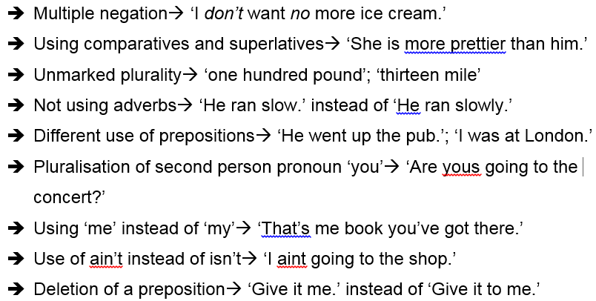
Non-Standard Grammatical Forms in Dialect

Slide 25
Status and Power
How might we indicate higher status in spoken language?
Modes of Address
Asking questions
Making requests (imperatives)
Agenda- setting
Saying more than other speakers
Interrupting other speakers
Ignoring other speakers
Using complex of field-specific vocabulary
Expressing dominance through body language and prosodic features

